Slide 1
PROVIDE INSIGHTS TO THE MARKETING TEAM IN FOOD & BEVERAGE INDUSTRY

Slide 2
Problem Statement
CodeX is a German beverage company that is aiming to make its mark in the Indian market. A few months ago, they launched their energy drink in 10 cities in India.
Their Marketing team is responsible for increasing brand awareness, market share, and product development. They conducted a survey in those 10 cities and received results from 10k respondents. Peter Pandey, a marketing data analyst is tasked to convert these survey results to meaningful insights which the team can use to drive actions.

Slide 3
Tools Used
Microsoft SQL Server Management Studio
Power BI
Power Point
Excel

Slide 4
DEMOGRAPHIC INSIGHTS

Slide 5

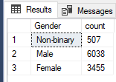
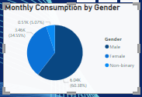
a.Who prefers energy drink more?
select Gender, count(respondent_ID) as count
from dim_repondents
group by Gender
There are total of 10000 respondents in the survey.
Among them there are 6038 males who prefer energy drink ,3455 females and remaining are non binary respondents
Most of the males prefer to drink energy drinks to increase energy and fatigue when compared to females and others.

Slide 6
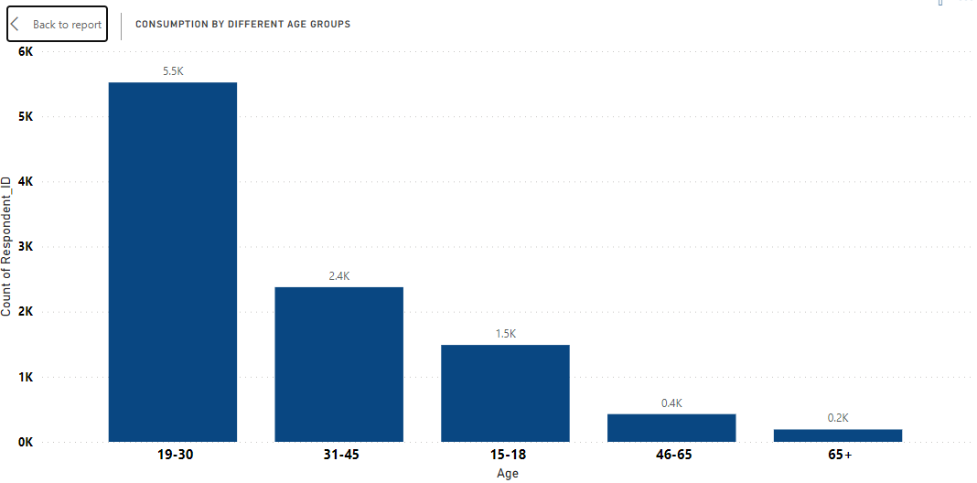
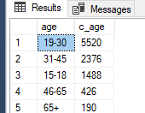
b.Which age group prefers energy drink more?
select age,count(respondent_ID) as c_age from dim_repondents group by age order by c_age desc
As you can see from above people in age group of 19-30 years prefer to drink energy drink more when compared to others so we need to focus our branding and marketing targeting the audience in this age group by attracting them with Genz themes and their taste preferences and conducting some events which help them to know more about the brand.

Slide 7
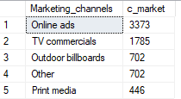
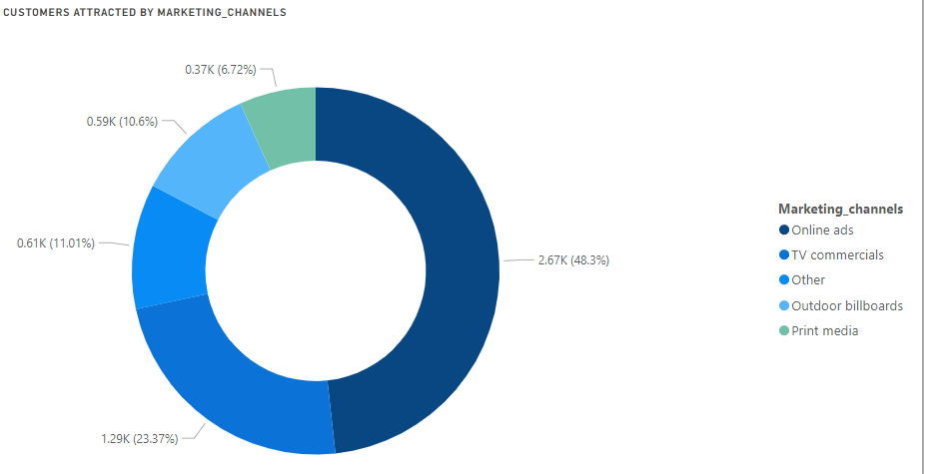
c.Which type of marketing reaches the most youth.
select f.Marketing_channels,count(f.respondent_ID) as c_market from fact_survey_responses f join dim_repondents r
on f.Respondent_ID=r.Respondent_ID
where r.Age='15-18' or r.Age='19-30'
group by f.Marketing_channels order by c_market DESC
Most of the youth are attracted by online ads so we can focus on influencer marketing, keeping ads on streaming platforms and using social media to gain more popularity

Slide 8
Consumer Preferences

Slide 9
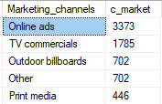
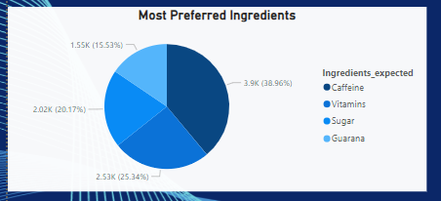
a.What are preferred ingredients of energy drinks among respondents?
select Ingredients_expected,count(respondent_ID) as C_ingredients_expected from fact_survey_responses group by Ingredients_expected order by Ingredients_expected DESC
Caffeine is the most prefered ingredient in the energy drinks. Caffeine is consumed worldwide for its stimulating effects on the central nervous system,
which can help reduce fatigue and improve alertness.

Slide 10
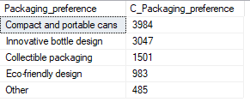
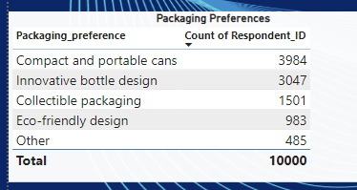
b. What packaging preferences do respondents have for energy drinks?
select Packaging_preference,count(respondent_ID) as C_Packaging_preference from fact_survey_responses group by Packaging_preference order by C_Packaging_preference desc
Youth mostly prefer compact and portable cans as it is easy to use and looks stylish while carrying around. We can elevate them by printing some unique designs and art to attract youth and encourage them to use eco friendly packaging.

Slide 11
Competitive Analysis

Slide 12
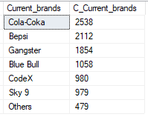
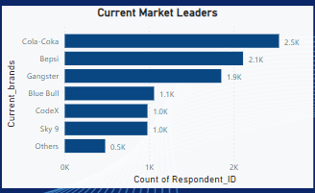
a.Who are current market leaders.
select Current_brands,COUNT(response_id) as C_Current_brands from fact_survey_responses group by Current_brands order by C_Current_brands DESC
Cola-Coka is the current market leader and has major market share and CodeX is in fifth position .

Slide 13
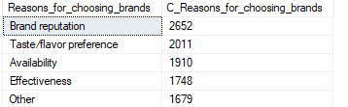
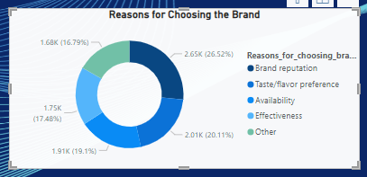
b.What are the primary reasons consumers prefer those brands?
select Reasons_for_choosing_brands,COUNT(response_id) as C_Reasons_for_choosing_brands from fact_survey_responses group by Reasons_for_choosing_brands order by C_Reasons_for_choosing_brands DESC
Brand reputation is the most common reason for choosing the drinks so we can see we need to work on improving the brand marketing.

Slide 14
Marketing Channels and Brand Awareness

Slide 15
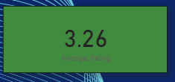


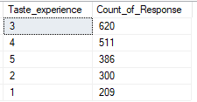
a.What do people think about the brand?
3.26 is the average rating given by those who has tried CodeX drink
select count(*) as Heard_before_count from fact_survey_responses Where Heard_before='Yes‘
select count(*) as Tried_before from fact_survey_responses
Where Tried_before='yes'
SELECT Taste_experience, COUNT(Respondent_ID) AS Count_of_Response
FROM fact_survey_responses
Where Tried_before='yes' AND Heard_before='Yes'
GROUP BY Taste_experience
ORDER BY Count_of_Response DESC;

Slide 16
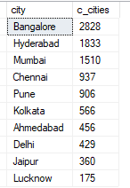
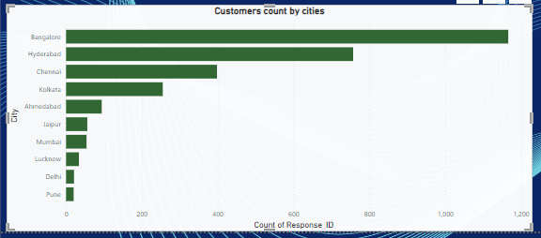
b.Which cities do we need to focus more on?
select c.city,count(f.respondent_ID) as c_cities from dim_cities c join dim_repondents r on c.City_ID=r.City_ID join fact_survey_responses f on r.Respondent_ID=f.Respondent_ID group by c.city order by c_cities DESC
We can see from below graph that Banglore is the city with most customers with Delhi and pune will less count. So we need to focus more on these cities.

Slide 17
Purchase Behaviour

Slide 18
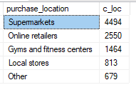
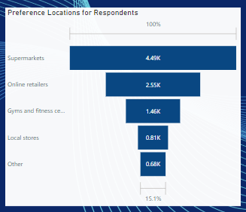
a. Where do respondents prefer to purchase energy drinks?
select purchase_location, COUNT(response_id) as c_loc from fact_survey_responses group by purchase_location order by c_loc DESC
Customers mostly buy energy drinks at super markets

Slide 19
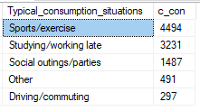
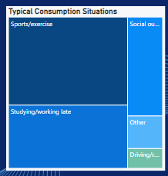
b. What are the typical consumption situations for energy drinks among respondents?
select Typical_consumption_situations, COUNT(Typical_consumption_situations) as c_con from fact_survey_responses group by Typical_consumption_situations order by c_con DESC
Sports /Exercise is the common consumption situations where people are drinking energy drinks as it boosts their strength to do exercise and be strong while playing sports.
So we can use some sports players and fitness influencers to market our brand to tell about the uses of this energy drink.

Slide 20
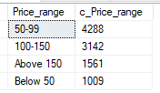
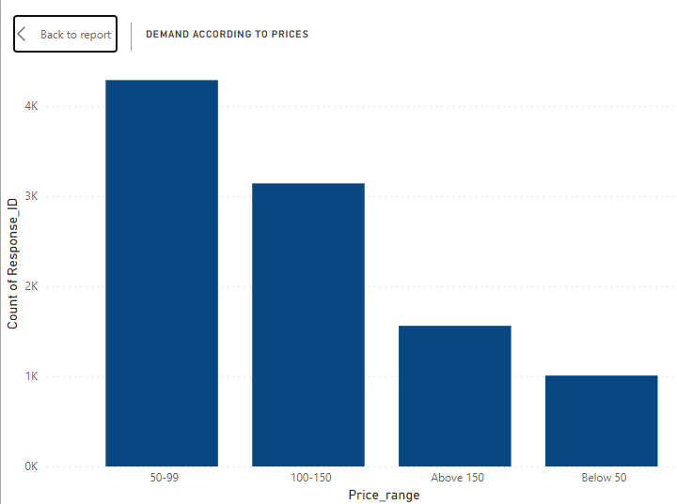
c.What factors influence respondants purchase decisions,such as price range and limited edition packaging?
select Price_range, COUNT(Price_range) as c_Price_range from fact_survey_responses group by Price_range order by c_Price_range DESC
According to the survey, most of the people prefer the energy drinks in price range of 50-99

Slide 21

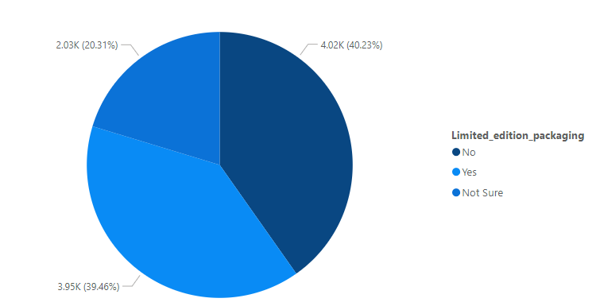
select Limited_edition_packaging, COUNT(Limited_edition_packaging) as c_con from fact_survey_responses group by Limited_edition_packaging order by c_con DESC

Slide 22
Product Development

Slide 23
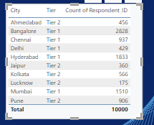
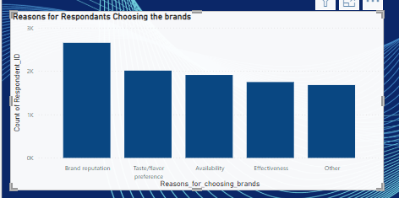
what area should we focus more on our product development
We need to focus more on branding and promoting the product via online ads .
Bring more awareness about the energy drinks in tier 2 cities where there are less responses from.
We can increase the taste experience by providing natural ingredients and considering customer preferences and being more organic and focus on health concerns.

Slide 24
Recommendations for CodeX

Slide 25
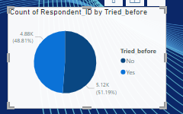
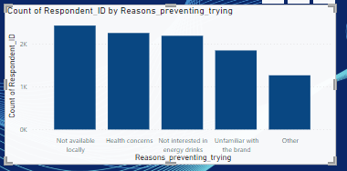
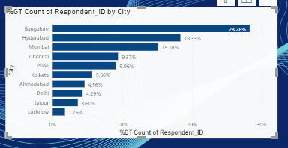
What immediate improvements can we bring to the product?
We need to focus more on brand reputation and to make the company stand among the top performers.
Keeping some campaigns in cafes and supermarkets where sales are mostly concerntrated to get people try the drink as there are 51.19% people who haven’t tried the brand.
We need to make product available in the market as 24.31% of people are not trying the product as it is not available locally.
We need to concerntrate on locations like delhi,jaipur,lucknow where responses are 20% less compared to highest consumer city banglore.

Slide 26
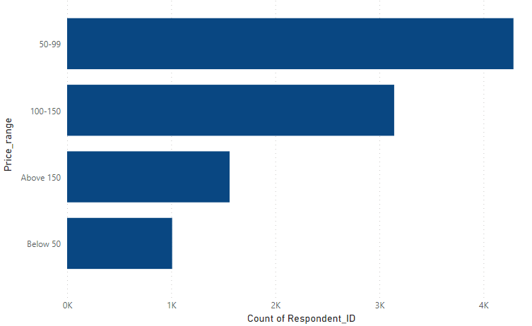
What should be the ideal price of our product?
Most respondants consider 50-99 is the reasonable price for an energy drink so depending on the cost of production and marketing charges and as youth are the one who consume more,keeping the indian market prices and other energy drinks we can fix a price range to an average of Rs 75

Slide 27
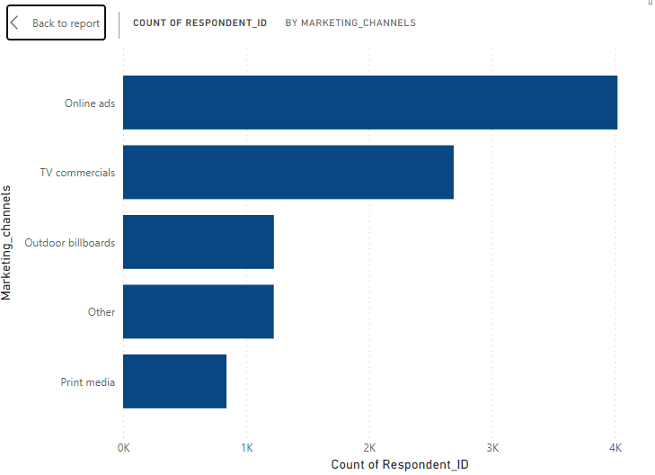
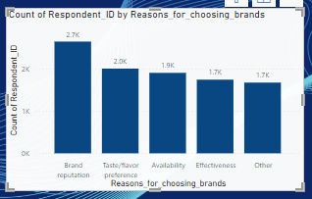
What kind of marketing campaigns,offers and discounts we can run?
People are being mostly attracted to the brands through online ads so we do brand promotions with influencers on instagram and youtube
We can arrange small concerts in cities or colleges with focusing more on brand and letting people try the product for free to get taste experience so the brand to be known among the youth.
We can give buy one get one offers or in gyms we can provide this drinks on monthly basis by collaborating with gym on membership basis.

Slide 28
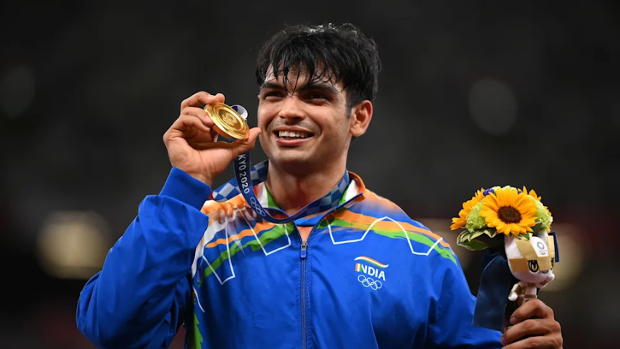
Who can be a brand ambassador and why?
Neeraj Chopra's Olympic gold medal in javelin throw signifies exceptional athleticism, aligning well with the energy and vitality associated with energy drinks.
As a dynamic and young sports icon, Neeraj appeals to the target demographic for energy drinks, connecting with the youth and their active lifestyles.
Neeraj's commitment to fitness and a healthy lifestyle reinforces the positive image of energy drinks as a source of energy for those leading active and health-conscious lives.
Being an Olympic gold medalist, Neeraj evokes a sense of national pride, offering the brand an opportunity to align with a celebrated figure and connect emotionally with consumers.
Neeraj's widespread media visibility and inspirational journey from a small town to Olympic success provide the brand with a platform for effective marketing, creating a narrative of motivation and triumph that resonates with consumers.

Slide 29
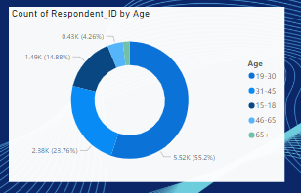
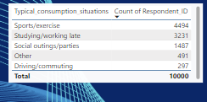
Who should be our target audience
Focus should be on people in the age group of 15-30 as young people in India mostly tend to drink energy drinks.
As we can see 44% of people doing sports /exercise are consuming the drink more so we can focus in sports sector by sponsoring in cricket ,kabaddi matches and promoting in gyms .

Slide 30
THANK YOU

